Slide 1
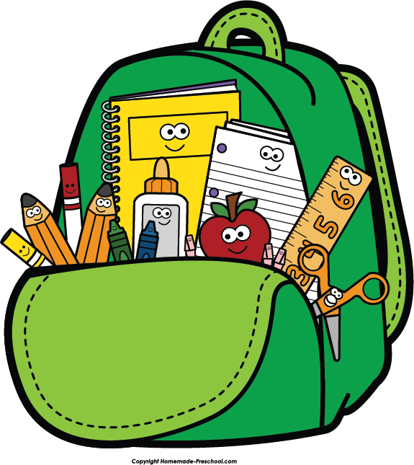
Red Words

Slide 2
do

Slide 3
you

Slide 4
for
Notes:
It

Slide 5
he

Slide 6
ten

Slide 7
am

Slide 8
are

Slide 9
she

Slide 10
be

Slide 11
so

Slide 12
here

Slide 13
go

